Slide 1

Controlling Volume with Hand Gestures using a Webcam
M2-Gesture Recognition and Distance Measurement Module
Mentor:Dr. D.Bhanu Prakash Presented by:Oviya K P
Saveetha Engineering College

Slide 2
Milestone 2-Gesture Recognition and Distance Measurement Module
The distance between thumb and index finger tips will be calculated.
Gestures will be classified based on this distance to represent control actions.
Output Screenshots:
  Live camera feed with gesture annotations
  Calculated distance values shown in overlay

Slide 3
✋ Gesture Recognition and Distance Measurement
Importing Libraries
Initializing MediaPipe Hands
Capturing Frame from Webcam
Processing the frame

Slide 4
Importing Libraries
Library | Functional Area
MediaPipe | Core Detection Framework
numpy | Numerical Computation
pandas | Data Management
matplotlib.pyplot | Visualization/Analysis
Video Capture Modules | Input and Preprocessing

Slide 5
Initializing MediaPipe
mp_hands = mp.solutions.hands
mp_drawing = mp.solutions.drawing_utils
hands = mp_hands.Hands(
  static_image_mode = False,
  max_num_hands = 2,
  min_detection_confidence = 0.75,
  min_tracking_confidence = 0.75)
Sets up the hand detection model with specified parameters and options like tracking enabled.
Detects up to 2 hands and tracks 21 key landmarks per hand.

Slide 6

Distance Calculation
1. Core Calculation
  Metric: 3D Euclidean Distance for superior spatial accuracy.
  Target: Measuring distance between Thumb and Index Tips.
2. Reliability & Consistency
  Data: Uses Normalized Coordinates for input.
  Benefit: Ensures Scale-Invariant Precision across all resolutions.
3. Application
  Function: Foundation for Real-Time Pinch Detection.
  Result: Enables Interactive Gesture Control.

Slide 7
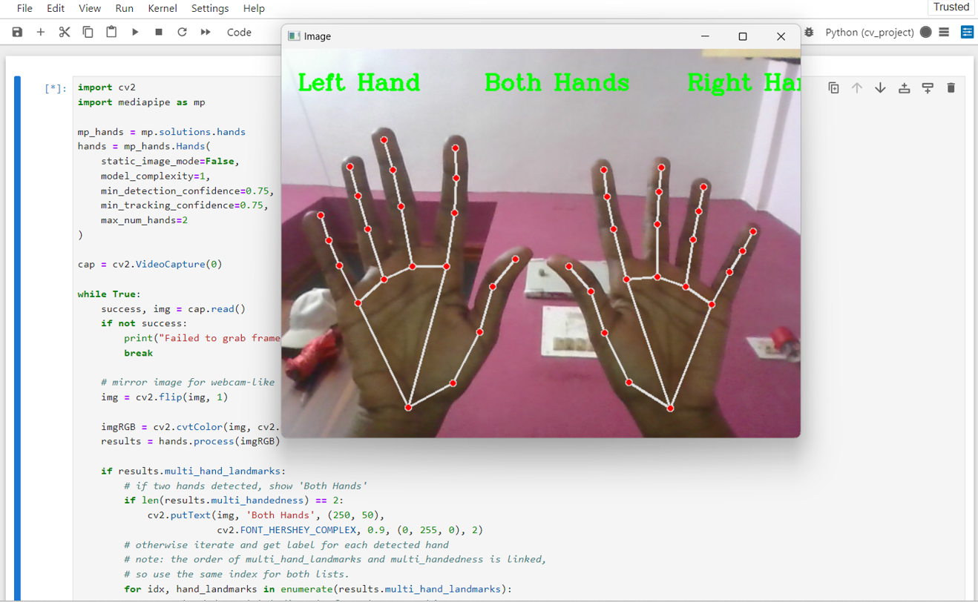

Slide 8
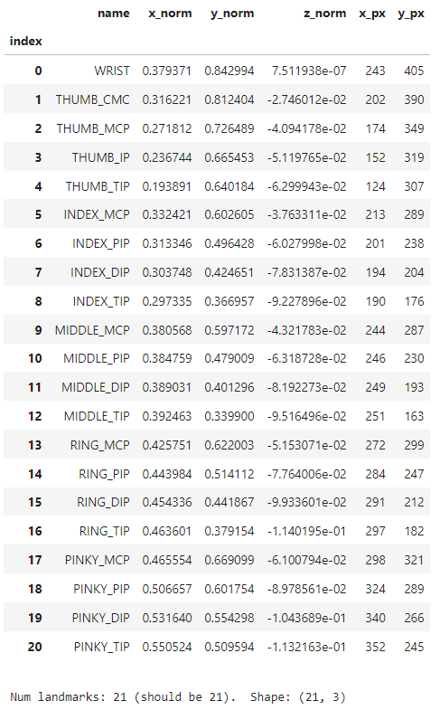
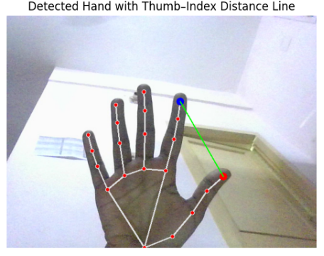

Slide 9
Thank you

